Slide 1
Rockbuster Stealth Data Analysis Project
BY TANHA TAHSEEN

Slide 2
Introduction
Rockbuster Stealth LLC is a movie rental company that used to have stores around the world.
Facing stiff competition from streaming services such as Netflix and Amazon Prime, the Rockbuster Stealth management team is planning to use its existing movie licenses to launch an online video rental service in order to stay competitive.

Slide 3
Key Questions and Objectives
The Rockbuster Stealth Management Board has asked a series of business questions and they expect data-driven answers that they can use for their 2020 company strategy. Here are the main questions they’d like to answer:
● Which movies contributed the most/least to revenue gain?
● What was the average rental duration for all videos?
● Which countries are Rockbuster customers based in?
● Where are customers with a high lifetime value based?
● Do sales figures vary between geographic regions?

Slide 4
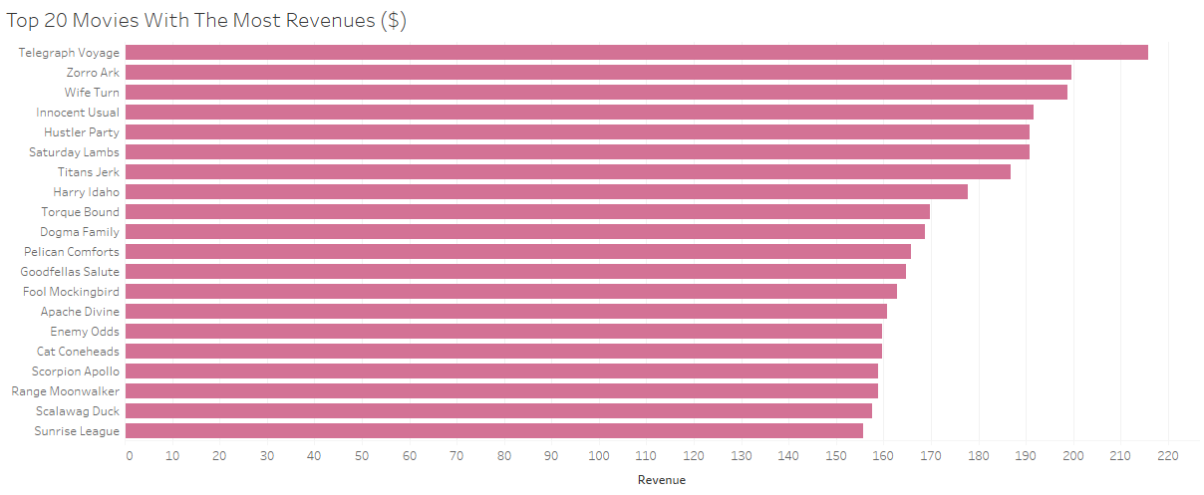
Which movies contributed the most/least to revenue gain?

Slide 5
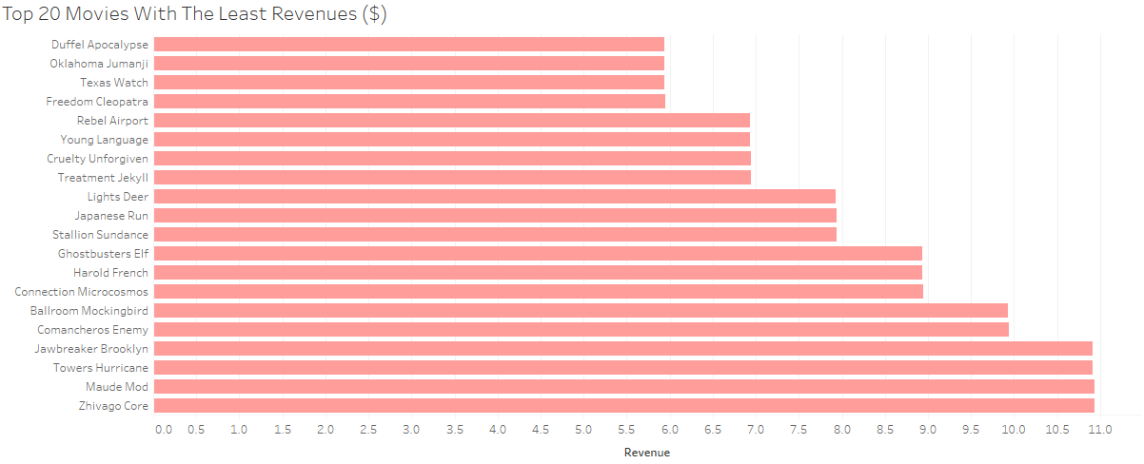
Which movies contributed the most/least to revenue gain?

Slide 6
What was the average rental duration for all videos?
Average rental duration: 5 days
Total number of films: 1000
Total number of customers: 599

Slide 7
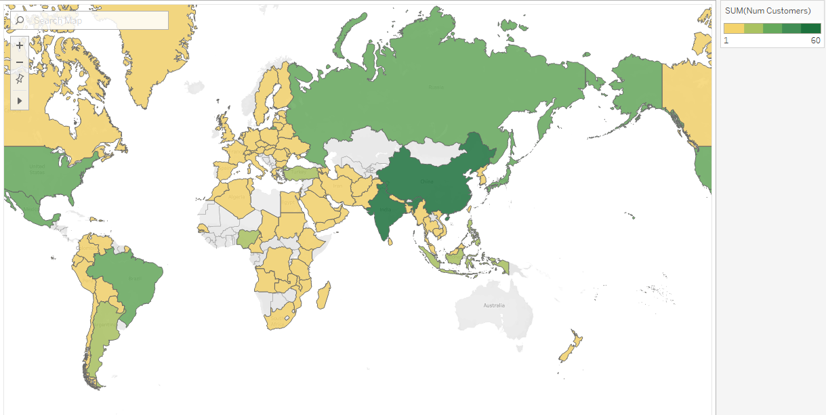
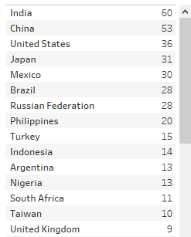
Which countries are Rockbuster customers based in?

Slide 8
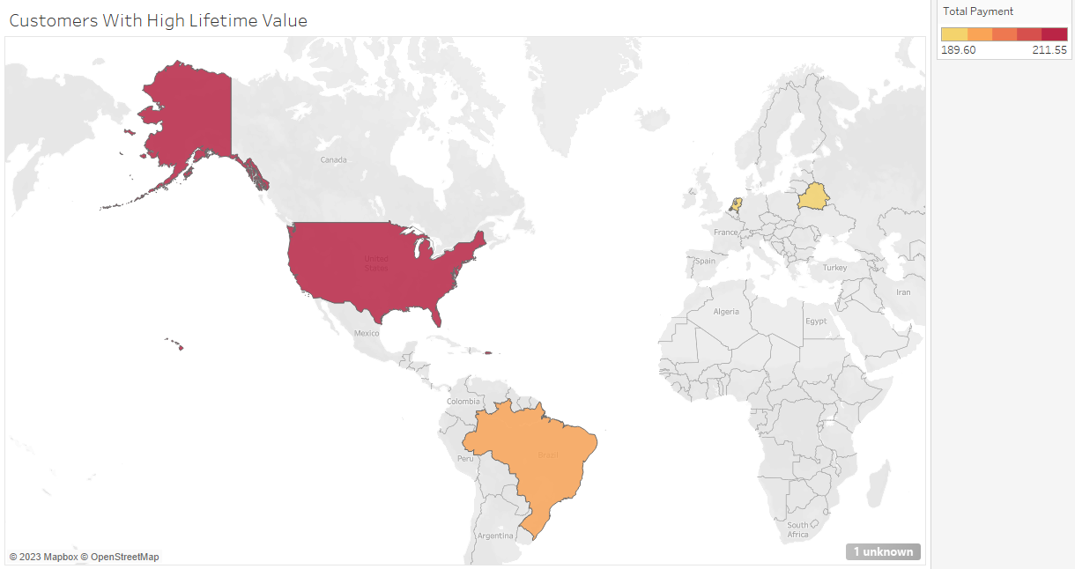
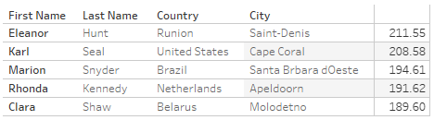
Where are customers with a high lifetime value based?

Slide 9
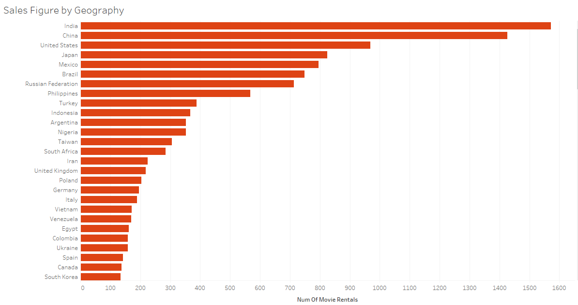
Do sales figures vary between geographic regions?

Slide 10
Tableau Links
Top 20 Movies With The Most Revenues($): https://public.tableau.com/views/Movieswithmostrevenue/Movieswithmostrevenue?:language=en-US&:display_count=n&:origin=viz_share_link
Top 20 Movies With The Least Revenues($): https://public.tableau.com/views/Movieswithleastrevenue/Movieswithleastrevenue?:language=en-US&:display_count=n&:origin=viz_share_link
Countries by customer number map: https://public.tableau.com/views/Countriesbycustomernumbermap/Countriesbycustomernumbermap?:language=en-US&:display_count=n&:origin=viz_share_link
Customers With High Lifetime Value: https://public.tableau.com/views/Customers_high_lifetime_UPDATED/Customers_high_lifetime_Updated?:language=en-US&publish=yes&:display_count=n&:origin=viz_share_link
Sales Figure by Geography: https://public.tableau.com/views/SalesFigurebyGeography/SalesFigurebyGeography?:language=en-US&:display_count=n&:origin=viz_share_link

